Slide 1

Key E-commerce Insights from Order Data
Enhancing Business Growth through Data Analysis
Jayeesha Chakraborty

Slide 2
Objective of the Analysis
Current Market Position
Assess revenue, product, and brand performance.
Identify Gaps
Highlight underperforming areas and potential growth opportunities.
Optimize Strategy
Leverage data to improve revenue generation, customer satisfaction, and operational efficiency.

Slide 3
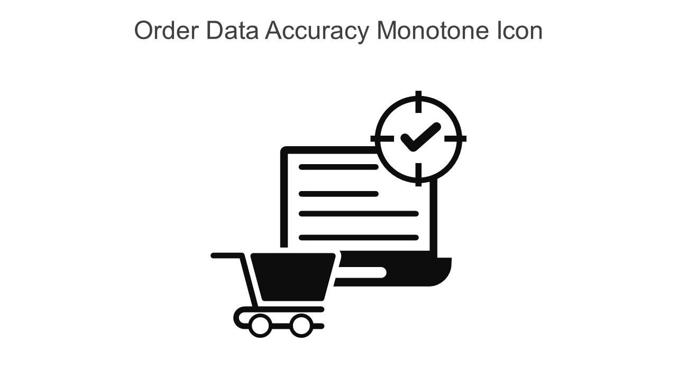
Data Overview
8906 order records with 17 features
No missing or duplicate records
Brand, Product category, Region and Order month are important dimension to get insights
Revenue can be derived from the data based on the company’s charge policy from retailers.

Slide 4

Questions Driving the Analysis
Top 5 Best Selling Product Categories
Top 10 Brands in terms of Revenue
Top 10 customer favorite Brands
Region-wise monthly Revenue performance
Price distribution and pricing strategy
Delivery delays and category-wise delays

Slide 5
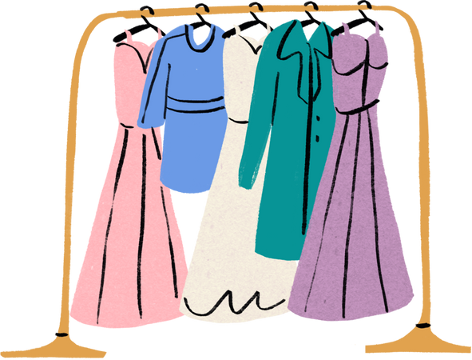




Top 5 Best Selling Product Categories
Clothing
Mobile and Accessories
Automotive
Home Decor
Computers
2943 orders
1084 orders
1001 orders
727 orders
558 orders

Slide 6

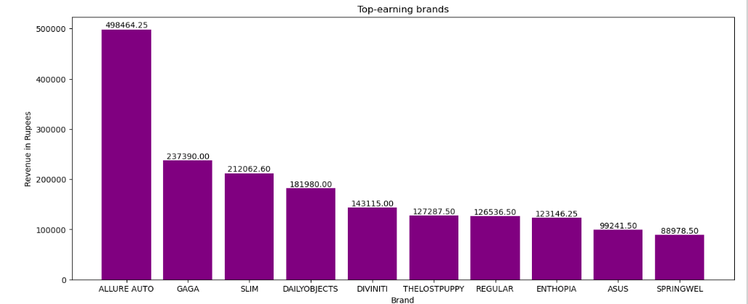
Top Revenue-leading Brands

Slide 7
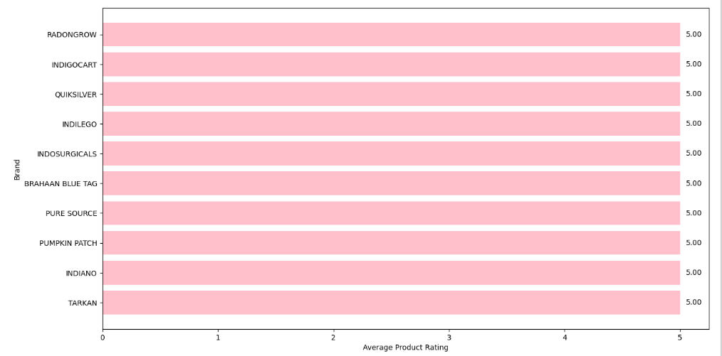
Top 10 customer favorite Brands

Slide 8
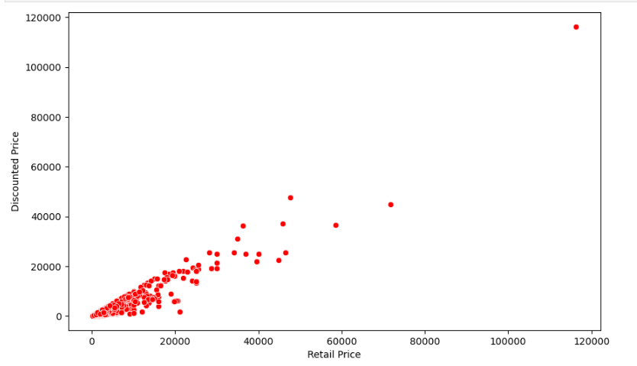
COMPANY REVENUE
As per the company’s charge policy from the retailers, the company generated total Revenue of 2.85 M
Relation between retail and discounted price
BRAND REVENUE
Deducting the company revenue from the total sale price, gross brand revenue came as 7.15 M
RETAIL PRICE AND DISCOUNT PRICE
Positive correlation between Retail Price and Discounted Price indicates that higher retail prices are associated with higher discounted prices. This could mean that the company maintains a consistent discount percentage across different price ranges.
Pricing Insights

Slide 9
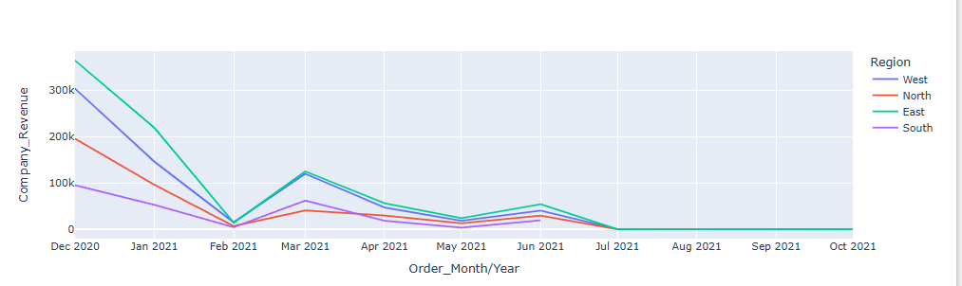
Region-wise monthly Company Revenue performance

Slide 10
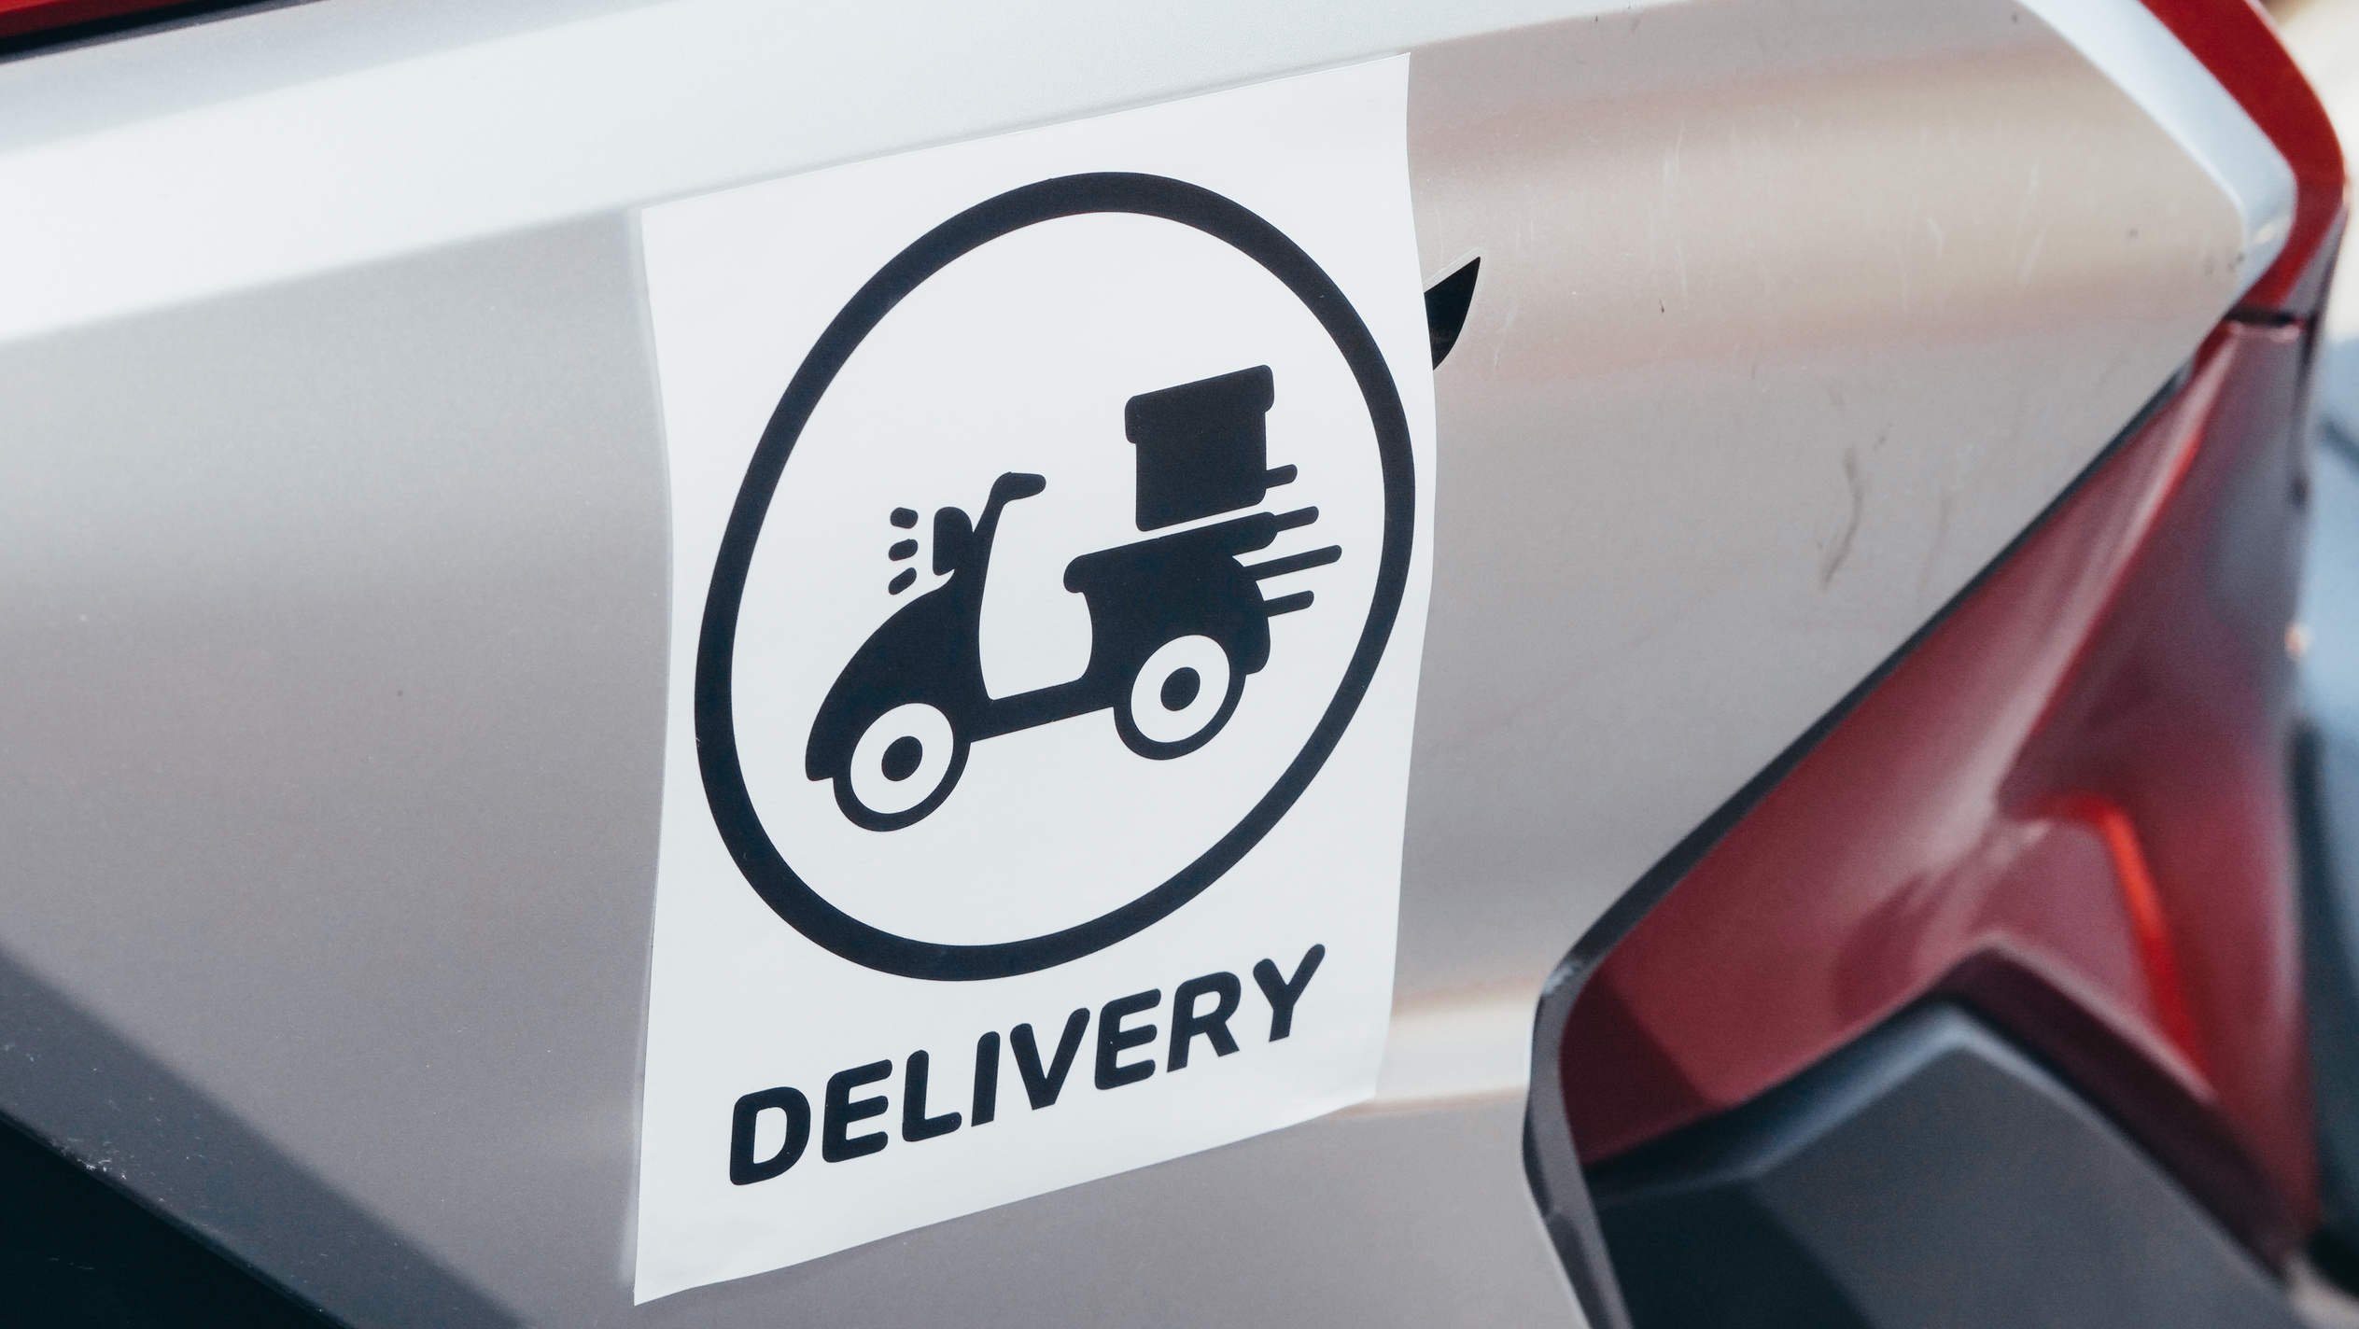
Delivery Performance Insights
On-Time Deliveries: 8,607 orders delivered without any delays
Fast Delivery Commitment: Maximum delivery time is just 7 days from order placement
The maximum delay observed: 3 days, affecting 7 orders
Maximum Delay Category: Clothing Products
Maximum Delay Recorded: January 2021

Slide 11
Key Insights & Recommendations for Growth
Given that clothing is the bestselling product category, we need to ensure adequate stock levels and streamline the supply chain to enhance customer satisfaction
Our company’s pricing strategy doesn’t seem to heavily rely on discounts to drive sales or revenue. Instead, other factors such as product quality, brand reputation, or marketing efforts might play a more significant role.
We need to investigate why the South region has been consistently underperforming and analyze why no orders have been generated since June 2021.
To boost sales for revenue-leading brands on our platform, we can offer exclusive promotions, enhanced visibility, and marketing support. Additionally, we may provide detailed performance analytics, streamline operations, and foster strong partnerships to drive further growth.

